Slide 1
SIMATS ENGINEERING
CAPSTONE PROJECT
An E-commerce Platform Must Meet Regulatory Requirements When Transferring Payment Information Between Different Regions. Analyze The Cryptographic Measures To Ensure Compliance And Security.
CSA5155– CRYPTOGRAPHY AND NETWORK SECURITY FOR BLOCK CHAIN
Supervisor
Mrs. J. Alphonsa
Presented by:
S. Niveditha (192221095)
P. Nagasai (192011187)

Slide 2




E-Commerce Payment Regulations: A Comprehensive Overview
This presentation will examine the crucial role of cryptography in ensuring the secure transfer of payment data in the e-commerce landscape, especially when navigating the complexities of cross-border transactions.

Slide 3
Secure Data Transfer Between Regions
Data Security
Compliance Considerations
Data security is paramount when transferring payment information across geographical boundaries. Implementing robust security measures is essential to protect sensitive information from unauthorized access.
Compliance with regulations like PCI DSS is crucial. These standards outline best practices for handling payment data, ensuring secure data transfer, and mitigating potential risks.

Slide 4


Cryptographic Principles
1
Confidentiality
Ensuring that only authorized individuals can access payment data. This is achieved through encryption techniques that make data unreadable to unauthorized parties.
2
Integrity
Maintaining the accuracy and completeness of payment information. This involves using cryptographic techniques to detect any unauthorized modifications or alterations to data.
3
Authentication
Verifying the identities of parties involved in the payment transaction. Authentication methods like digital certificates and digital signatures play a critical role in establishing trust and verifying identities.
4
Non-Repudiation
Preventing parties from denying their participation in the transaction. Digital signatures and timestamps provide irrefutable proof of origin and actions, ensuring accountability.

Slide 5

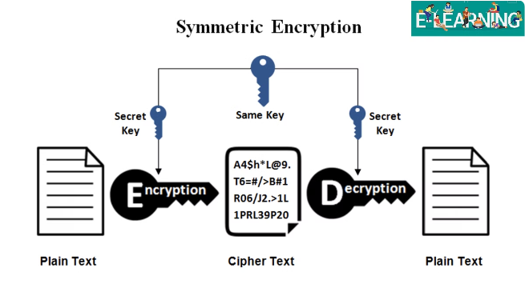
Symmetric Encryption for Payment Data
Key Sharing
Symmetric encryption employs a single key for both encryption and decryption. This key must be securely shared between the sender and recipient.
Speed and Efficiency
Symmetric encryption algorithms are generally faster and more efficient than asymmetric encryption methods, making them suitable for encrypting large volumes of data.
Key Management Challenges
Secure key distribution and management are critical in symmetric encryption. Compromising the key can expose all encrypted data.

Slide 6

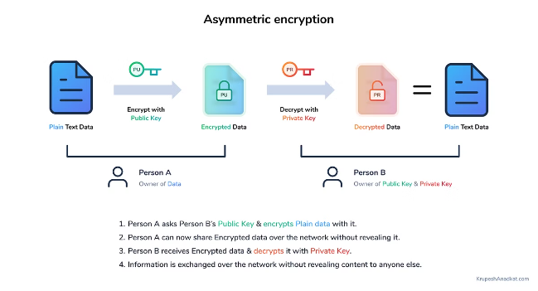



Asymmetric Encryption for Key Exchange
Public-Private Key Pairs
Asymmetric encryption involves two keys: a public key for encryption and a private key for decryption.
Key Exchange
The public key can be shared freely, while the private key remains secret. This allows parties to securely exchange encryption keys.
Secure Communication
Once the keys are exchanged, symmetric encryption can be used for secure communication, ensuring confidentiality and integrity.

Slide 7
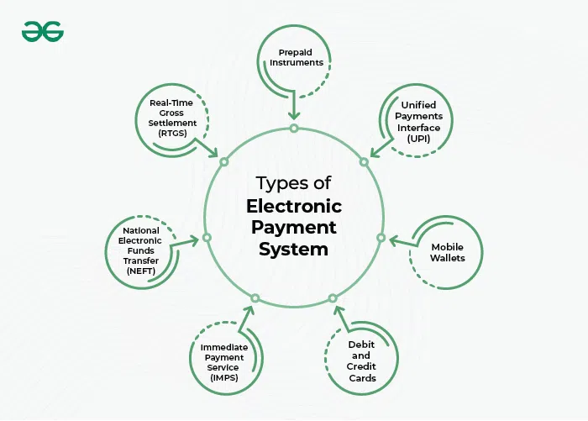
Digital Signatures for Non-Repudiation
Purpose
To verify the authenticity and integrity of data
Method
Uses a private key to create a unique signature that is attached to the data
Verification
The signature is validated using the corresponding public key, ensuring the sender's identity and the data's integrity
Benefits
Non-repudiation: prevents the sender from denying their actions

Slide 8


Hashing for Data Integrity
Unique Fingerprint
Integrity Verification
Security Enhancement
Hashing algorithms generate a unique, fixed-length hash value for a given data set. Any change to the data will result in a different hash value.
By comparing the hash value of the received data with the original hash, recipients can verify whether the data has been altered.
Hashing functions are crucial for ensuring data integrity, preventing tampering, and detecting unauthorized modifications.

Slide 9

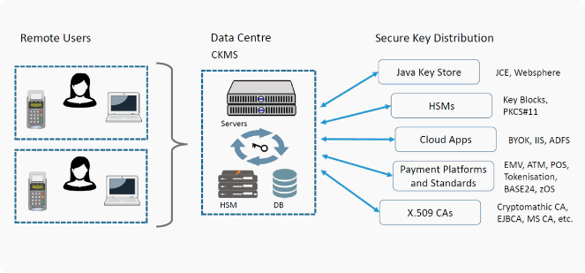
Key Management Best Practices
1
Key Generation
Keys should be generated using strong, random algorithms, ensuring their security and unpredictability.
2
Key Storage
Keys must be stored securely, using encryption, access control, and physical security measures to prevent unauthorized access.
3
Key Rotation
Regularly rotating keys is essential to mitigate the risk of compromise and maintain the effectiveness of encryption.
4
Key Revocation
A mechanism for revoking compromised keys should be in place, ensuring that invalid keys cannot be used for decryption.

Slide 10


Compliance with Industry Standards
1
PCI DSS Compliance
The Payment Card Industry Data Security Standard (PCI DSS) is a comprehensive set of security standards for organizations that handle credit card information.
2
Data Encryption
PCI DSS mandates the encryption of payment data at rest and in transit, ensuring its confidentiality and protecting it from unauthorized access.
3
Vulnerability Management
Regularly scanning for vulnerabilities and implementing security patches is essential to prevent unauthorized access and data breaches.
4
Security Awareness
Training employees on security best practices and raising awareness about security threats is vital to minimize the risk of human error.

Slide 11


Conclusion and Recommendations
E-commerce platforms must prioritize secure data transfer by implementing robust cryptographic measures and adhering to industry standards like PCI DSS. Continuous monitoring, regular security audits, and proactive risk management are essential for maintaining a secure payment environment.

Slide 12
THANK
YOU!

